Slide 1
Common Core State Standards: Its Impact on Secondary and Post-Secondary Education
January 8, 2013
The College of DuPage

Slide 2
Introductions
Community High School District 94
West Chicago
Maura Bridges, Director of Student Support Services
Allister Scott, Division Head of Math and Science
Moses Cheng, Principal

Slide 3
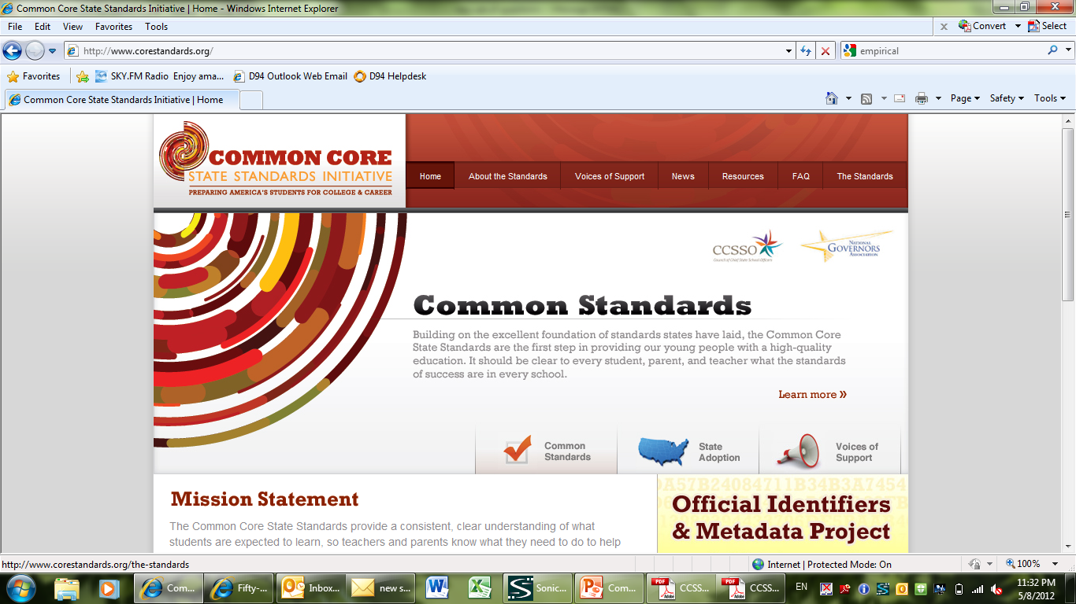
Common Core State Standards
Background:
www.corestandards.org

Slide 4
Common Core State Standards
Background:
Created through state led efforts.
National Governors Association Center for Best Practices (NGA Center)
Council of Chief State School Officers
Most effective models from states across the US and from the international community were referenced.

Slide 5
Common Core State Standards
Background:
They are optional. Currently adopted by 45 states. [Hawaii, Minnesota, Nebraska, Virginia, Texas]
Uniformity and consistency in what is being taught are established across the nation.
There is an increased emphasis on
preparing students for college and the workforce.
analysis, application, and creation of constructs.

Slide 6
Common Core State Standards
Background:
There is increased rigor and expectations in grade level benchmarks
A new state assessment to measure student achievement relative to CCSS is planned for implementation in Illinois for the 2014-2015 school year.

Slide 7
Common Core State Standards
Background:
There are 2 consortiums involved (separately) in creating the state assessments.
PARCC: Partnership for Assessment of Readiness for College and Careers (23 states)
Illinois
Assessment in Math and ELA
Grades 3 through 11
Smarter Balanced Assessment Consortium (25 states involved)

Slide 8
CCSS - Language Arts
Example:
Current IL Standards: Understand how literary elements and techniques are used to convey meaning
2.A.5d Evaluate the influence of historical context on form, style and point of view for a variety of literary works.
CCSS: Literature 9-10 - Integration of Knowledge and Ideas
8. Analyze how an author draws on and transforms source material in a specific work (e.g., how Shakespeare treats a theme or topic from Ovid or the Bible or how a later author draws on a play by Shakespeare).

Slide 9
CCSS - Language Arts
Focus on reading comprehension through increasing text complexity
Emphasis on…
Informational text as well as classic and contemporary literary works
Informational text = foundational U.S. documents, newspaper articles, manuals, websites, etc.
Argumentative writing
Establishing a claim, demonstrating reasoning, and using evidence.
Presenting complex information (communication)

Slide 10
CCSS - Language Arts
Example:
IL Standards: Compose well-organized and coherent writing for specific purposes and audiences.
3.B.4a. Produce documents that exhibit a range of writing techniques and appropriate to purpose and audience, with clarity of focus, logic of organization, appropriate elaboration and support and overall coherence.
CCSS: Writing 9-10
1. Write arguments to support claims in an analysis of substantive topics or texts, using valid reasoning and relevant and sufficient evidence.
a. Introduce precise claim(s), distinguish the claim(s) from alternate or opposing claims, and create an organization that establishes clear relationships among claim(s), counterclaims, reasons, and evidence.

Slide 11
CCSS - Mathematics
High School standards are described as conceptual categories rather than grade level standards.
Number and Quantity
Algebra
Functions
Modeling
Geometry
Statistics and Probability

Slide 12
CCSS - Mathematics
Example:
IL Standards: Use algebraic concepts and procedures to represent and solve problems.
8.D.4 Formulate and solve linear and quadratic equations and linear inequalities algebraically and investigate nonlinear inequalities using graphs, tables, calculators and computers.
CCSS: Algebra – reasoning with equations and inequalities – solve systems of equations
Prove that, given a system of two equations in two variables, replacing one equation by the sum of that equation and a multiple of the other produces a system with the same solutions.

Slide 13
CCSS - Mathematics
Emphasis on…
Procedural skills AND conceptual understanding
Applying mathematical ways of thinking to real world issues and challenges
Helping students develop a depth of understanding and an ability to apply mathematics to novel situations
The use of mathematics and statistics to analyze empirical situations, understand them better, and improve decisions [modeling]
Algebra preparedness and exposure at earlier age

Slide 14
CCSS - Mathematics
4 “pathways” for math instruction
Traditional: 2 algebra courses, 1 geometry course, data-probability-statistics included in courses (i.e. Algebra I, Geometry, Algebra II)
Integrated: (international) sequence of 3 courses with number, algebra, geometry, probability, and statistics taught in each of the 3 courses (i.e. Math I, Math II, Math III)
Compacted Traditional:
Compacted Integrated:
take what is taught in 7th, 8th, and 9th grade and compact it into 7th and 8th grade.

Slide 15
CCSS - Mathematics
8 “Standards” of mathematical practices
Make sense of problems and persevere in solving them
Reason abstractly and quantitatively
Construct viable arguments and critique the reasoning of others
Model with mathematics
Use appropriate tools strategically
Attend to precision
Look for and make use of structure
Look for and express regularity in repeated reasoning

Slide 16
Concluding thoughts
Summary of CCSS expectations:
Increased text complexity
Build knowledge
Explore possibilities
Broaden perspectives
Write logical arguments
Research

Slide 17
Concluding thoughts
Summary of CCSS expectations:
Present increasing complex information, ideas, and evidence
Support claims
Distinguish claims
Establish clear relationships among claims, counterclaims, reasons, and evidence
Use valid reasoning
Make informed, skillful choices

Slide 18
Concluding thoughts
Summary of CCSS expectations:
Express themselves through language
Stress conceptual understanding
Master content
Apply mathematical ways of thinking to real world issues and challenges
Utilize mathematical modeling
Analyze empirical situations

Slide 19
Concluding thoughts
[Potential] Future impact of CCSS
Students who will demonstrate…
mastery of skills and content
the ability to apply concepts to extrapolated thinking
higher levels of student attainment and achievement
greater levels of college and career readiness

Slide 20
Concluding thoughts
[Potential] Future impact of CCSS
Post secondary
Readiness
“PARCC College- and Career-ready Determination Policy In English Language Arts/Literacy And Mathematics & Policy-level Performance Level Descriptors”
http://www.parcconline.org/parcc-assessment-policies

Slide 21
Concluding thoughts
“One of PARCC’s primary objectives is that students who earn a College- and Career-Ready Determination and are admitted to two- or four-year public institutions of higher education will be exempted from having to take and pass placement tests designed to determine whether they are academically prepared to enter directly into entry-level, credit-bearing courses in ELA/literacy, mathematics, and technical courses requiring college-level reading, writing, or mathematics skills.”

Slide 22
Concluding thoughts
“In order to earn and maintain a College- and Career-Ready Determination in ELA/literacy, a student will need to achieve at least the threshold score for Level 4 on the grade 11 PARCC ELA/literacy assessment. In order to earn and maintain a College- and Career-Ready Determination in mathematics, a student will need to achieve at least the threshold score for Level 4 on the designated PARCC high school mathematics assessment(s).”

Slide 23
Concluding thoughts
This is a paradigm shift. It’s not just about what we teach but it’s also about how we teach.
CRISS Strategies
Understanding by Design
Sheltered Instruction Observation Protocol
Assessment
Differentiated Instruction
Alignment to the Common Core Standards is a process that will take time.
Common Core Standards impact all teachers.

Slide 24
Questions?

